Slide 1
Gesture Recognition in Intelligent Environment
Dr. David Ruby,
CSCI 264 (Artificial Intelligence)
Presenter: Jeevjyot Singh Chhabda

Slide 2
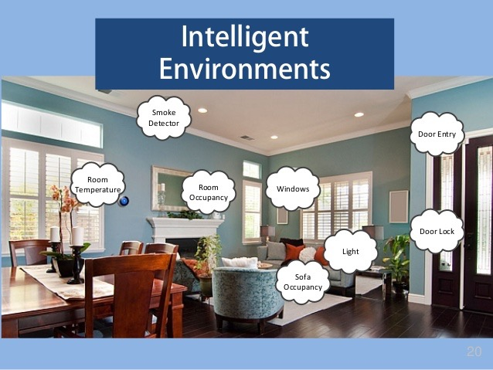
Intelligent Environment
Gesture Recognition
Notes:
Intelligent environments are spaces in which computation is seamlessly used to enhance ordinary activity.Essentially invisible to the user.
Gesture recognition is the mathematical interpretation of a human motion by a computing device. Gesture recognition, along with facial recognition, voice recognition, eye tracking and lip movement recognition are components of what developers refer to as a perceptual user interface (PUI).

Slide 3
Gesture Recognition
Gesture based Recognition, WHY?
Natural way to interact
Substitution for other form of communication
Extension to communication

Slide 4
…
2D Gesture
3D Gesture
Pointing Gesture
Static Vs Dynamic
Gesture Vs Gesticulation

Slide 5
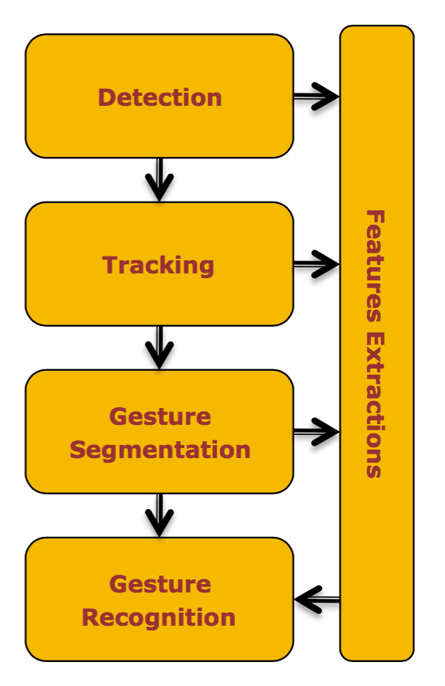
GR-Typical Approach
Detection
Tracking
Gesture Segmentation
Gesture Recognition

Slide 6
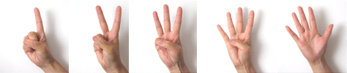

Hand Gesture Recognition
Cultural Hand recognition

Slide 7
Application of Hand Gesture Recognition
Sign Language Recognition
Robot control
Numbers recognition

Slide 8
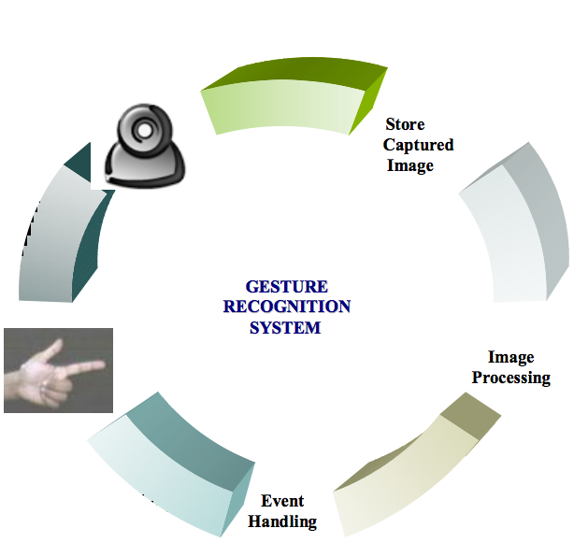
Architecture of Hand Recognition System
Human Generated Gesture
Web Camera Capturing human Gesture
Image Processing Algorithm
Event Handling
Back to Capturing Gestures

Slide 9
Requirements
2D Gesture Recognition System
A simple Webcam for capturing the images
An Algorithm to process the captured imaged

Slide 10
Implementation
Capture Frames from the Camera.
Smoothing: Thresholding and blurring.
Find Contours: A contour is the boundary following our Region of Interest.
Find Convex Hull and Convexity Defects.
Display the region.

Slide 11
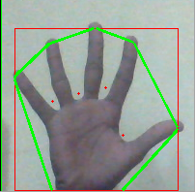
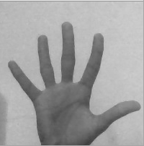


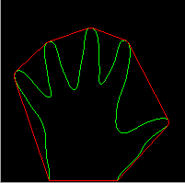
1
3
4
2

Slide 12
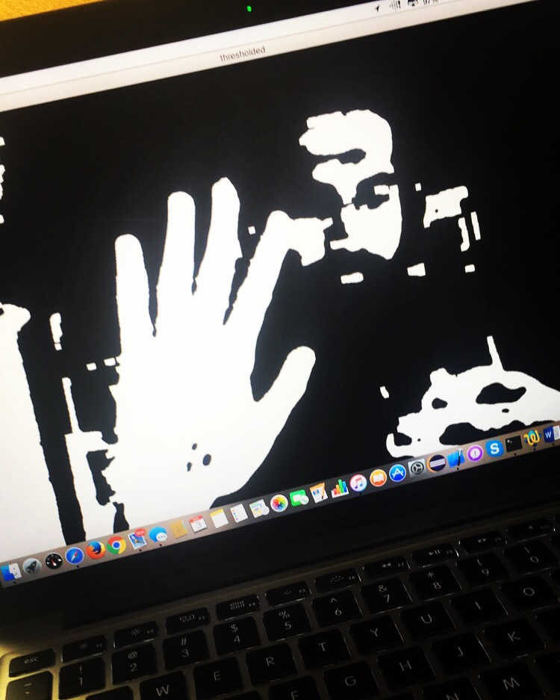
Output

Slide 13
Future Work
Train the System.
Integrate Gesture Recognition with some application.

Slide 14
Conclusion
Human hand gesture provide the most important means of non verbal interaction among people.
As present Artificial neural network are emerging for technology of choice for many application, such as gesture recognition, pattern recognition, stock market prediction and control etc.
Makes life better and simpler.

Slide 15
Thank-You

Slide 16
Any Queries?

